Slide 1
Smart Tourism
Students: Deleanu Teodora
Dinescu Ioana
Ionita Raluca
Ursu Andrei

Slide 2
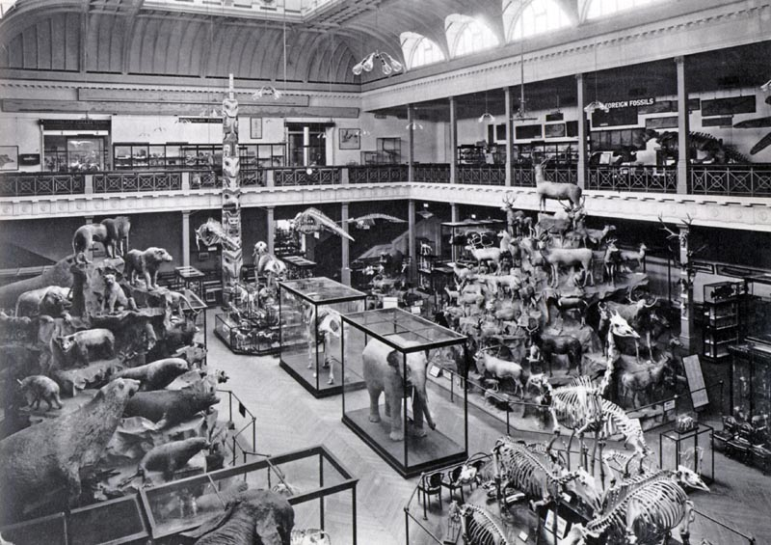
Current situation
Studies show that people are no longer as interested in visiting museums as in the past

Slide 3
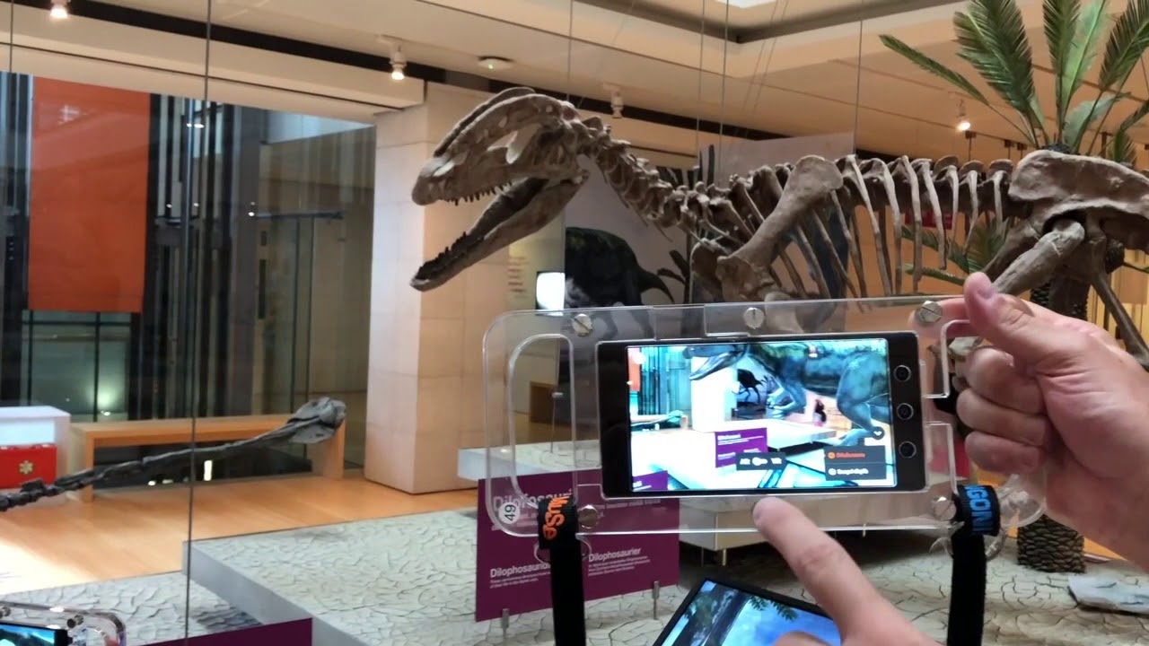
Our approach
Our solution to the issues is a platform that allows people to use their phone for a complete experience: from buying tickets to seeing 3D models of the exhibitions

Slide 4
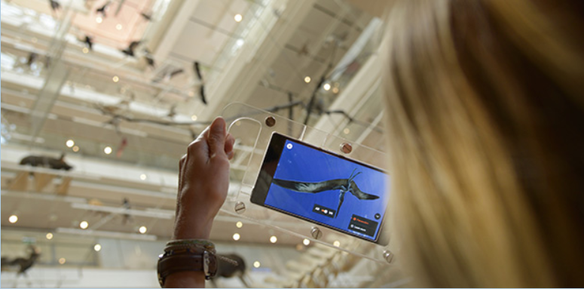
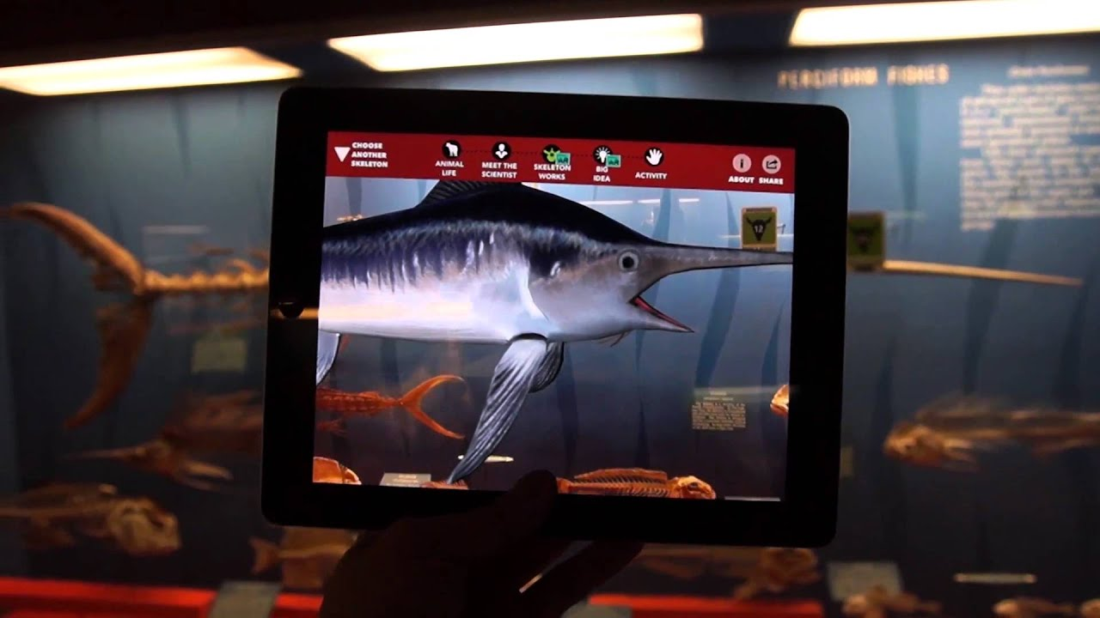
Similar applications
Go!Muse Application
Smithsonian Institution in Washington D.C

Slide 5
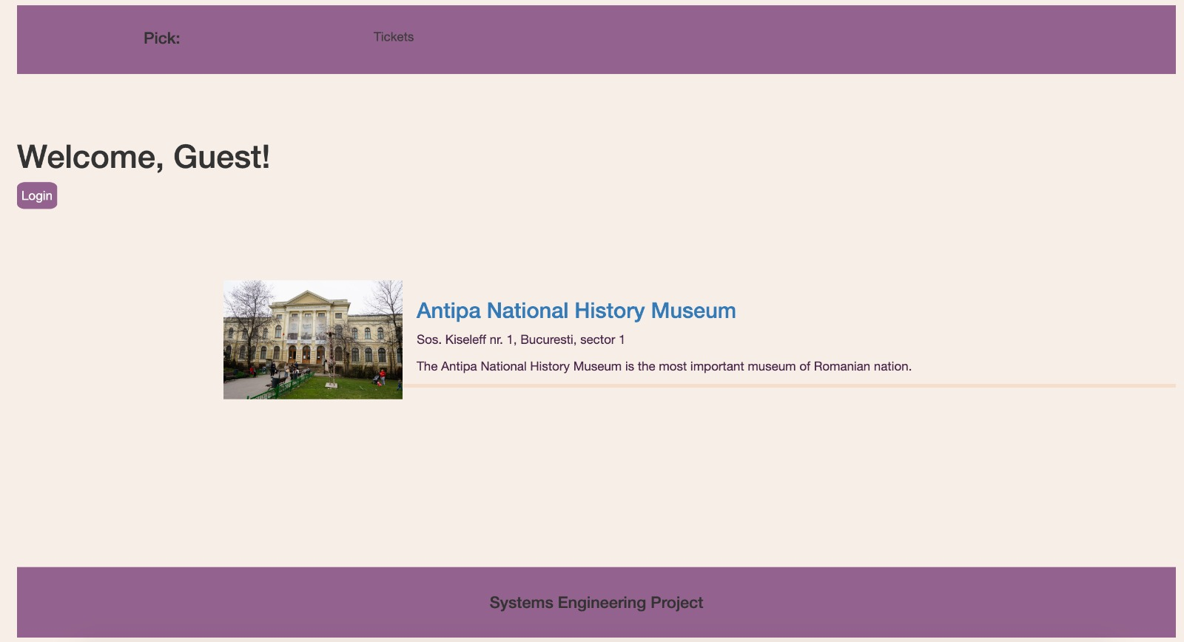
Web application
The web application deals with booking tickets, booking bus, providing information

Slide 6
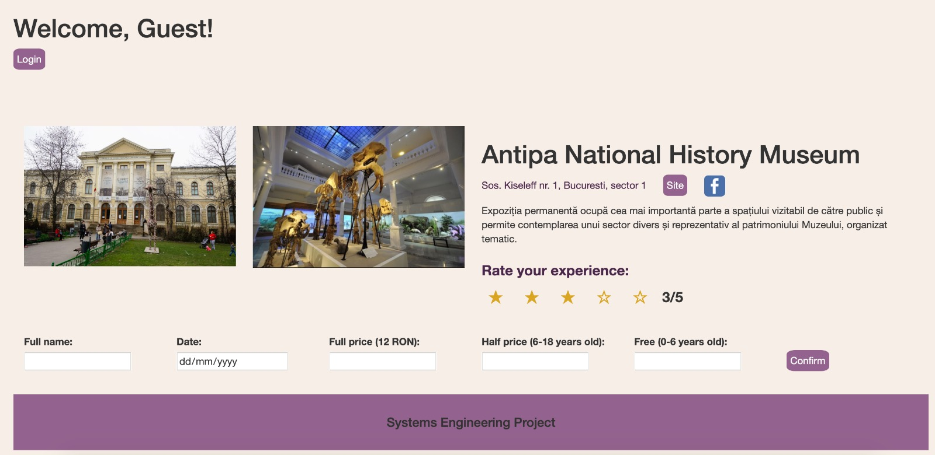
Web application

Slide 7
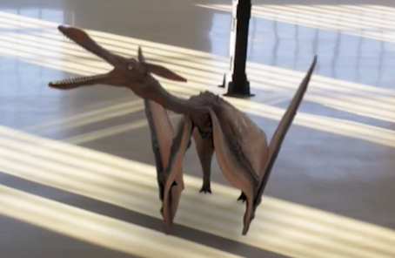
Mobile application
The application which enhances the experiences through AR

Slide 8
Smart tourism
We started with national history museums
In the future we plan to gather even more museums on our platform for an even more diversified experience

Slide 9
Conclusions
An easy-to-use, all-in-one application is the solution of enhancing museum experience
We think that this is just the beginning of smart tourism

Slide 10
Thank you for your attention!

